Slide 1

OOMAll
售后+服务+顾客需求分析汇报
The user can demonstrate on a projector or computer, or print the presentation and make it into a film to be used in a wider field
1-1组 丁圳杰 黄忠 李子晴 王义卿

Slide 2

01.售后需求分析
print the presentation and make it into a film to a wider field
02.服务需求分析
print the presentation and make it into a film to a wider field
CONTENT
03.顾客需求分析
print the presentation and make it into a film to a wider field

Slide 3
PART 01
售后模块需求分析
The user can demonstrate on a projector or computer, or print the presentation and make it into a film to be used in a wider field

Slide 4
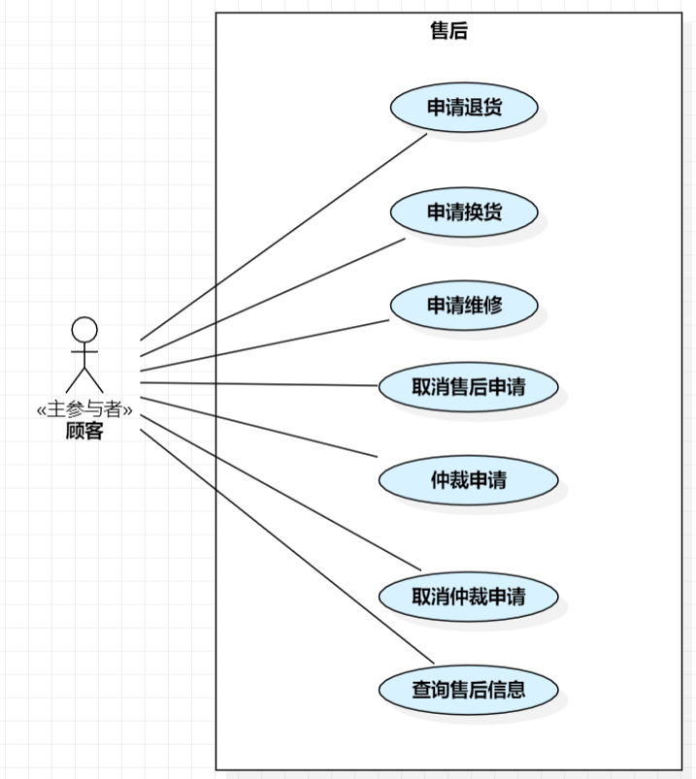
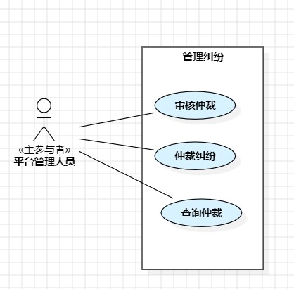
定义与售后相关的顾客用例
定义与售后相关的后台管理人员用例

Slide 5
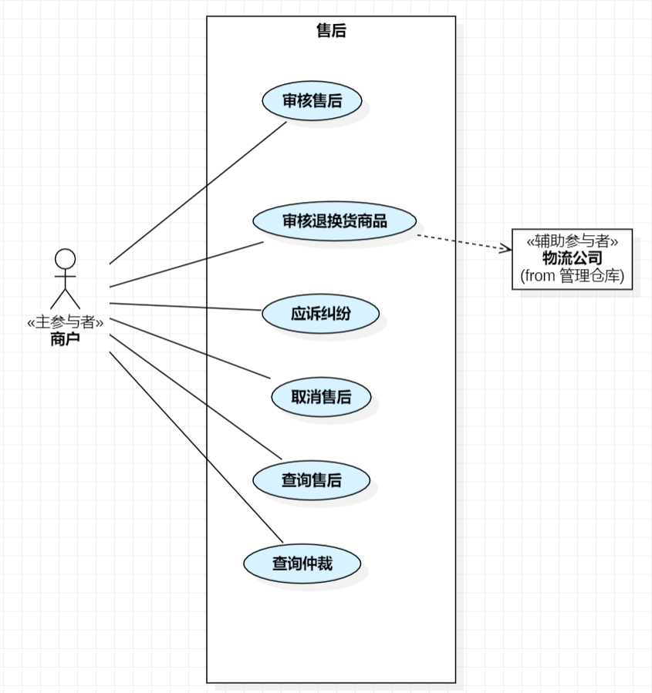
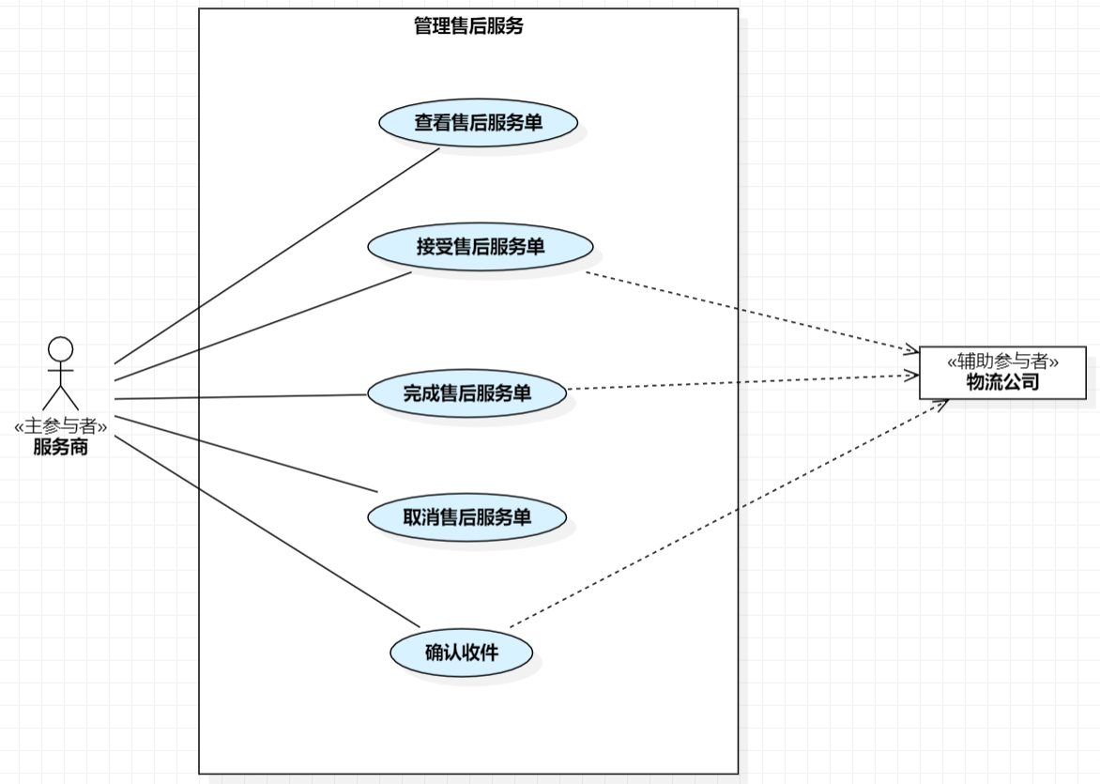
定义与售后相关的商户用例
定义与售后相关的服务商用例

Slide 6
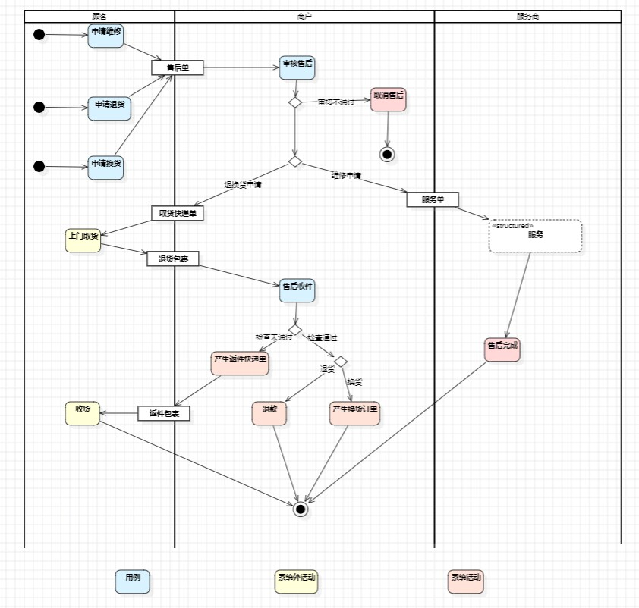
定义售后的业务流程

Slide 7
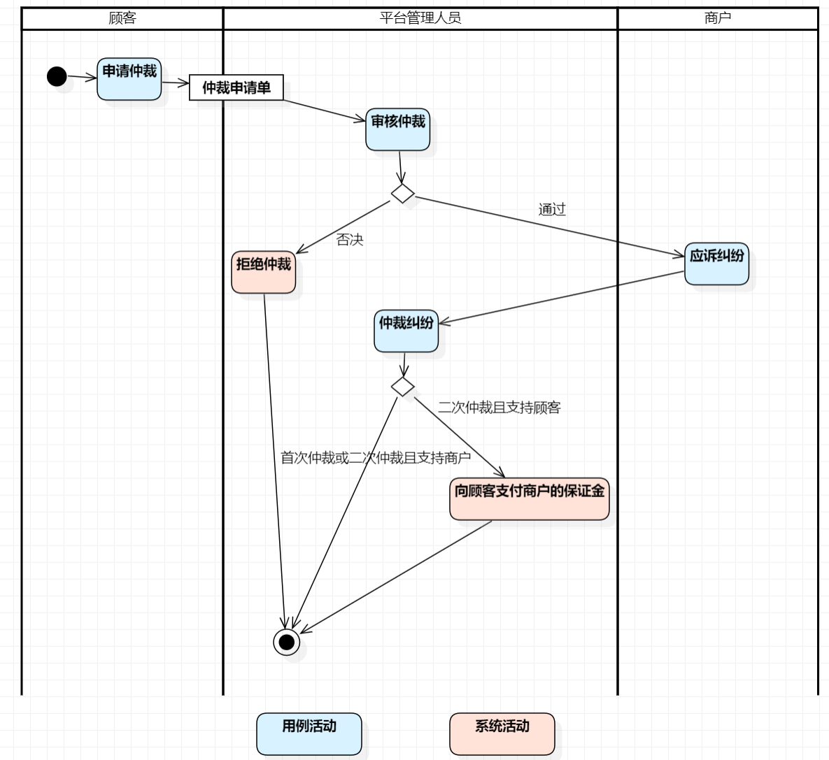
定义售后纠纷的业务流程

Slide 8
PART 02
服务模块需求分析
The user can demonstrate on a projector or computer, or print the presentation and make it into a film to be used in a wider field

Slide 9
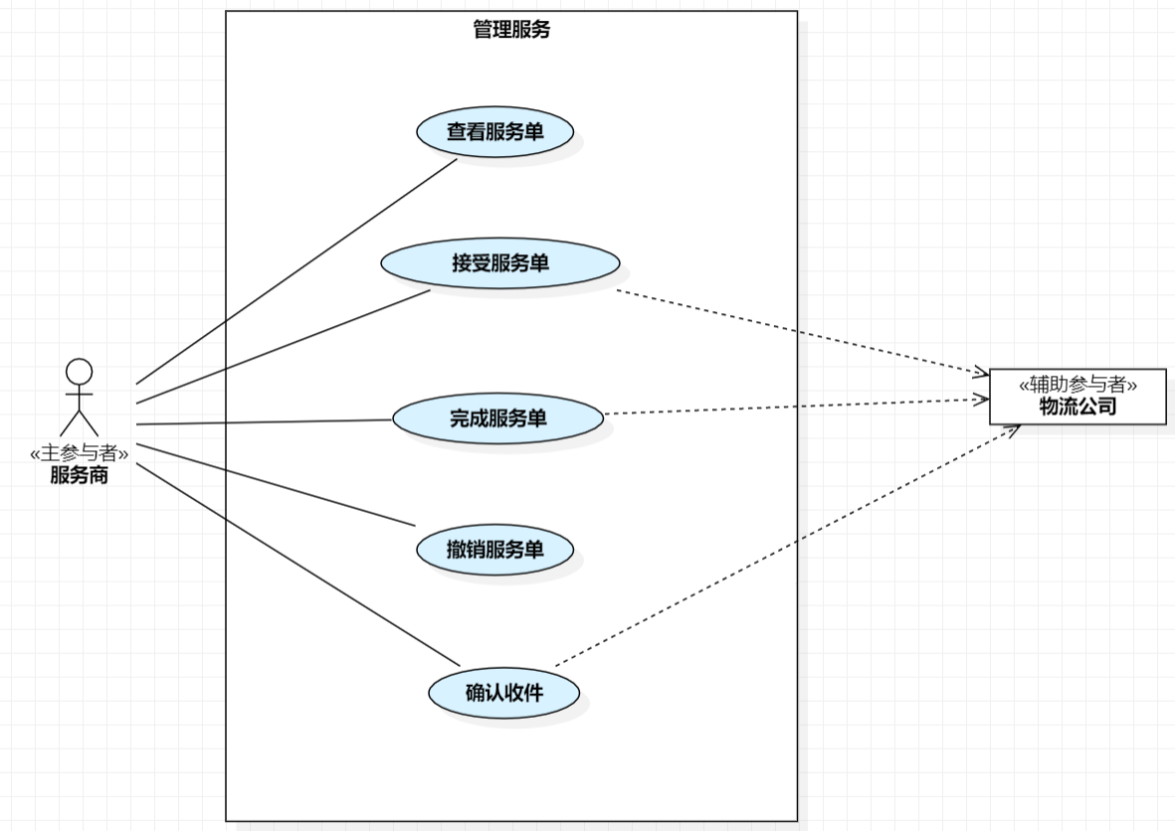
定义服务商用例

Slide 10
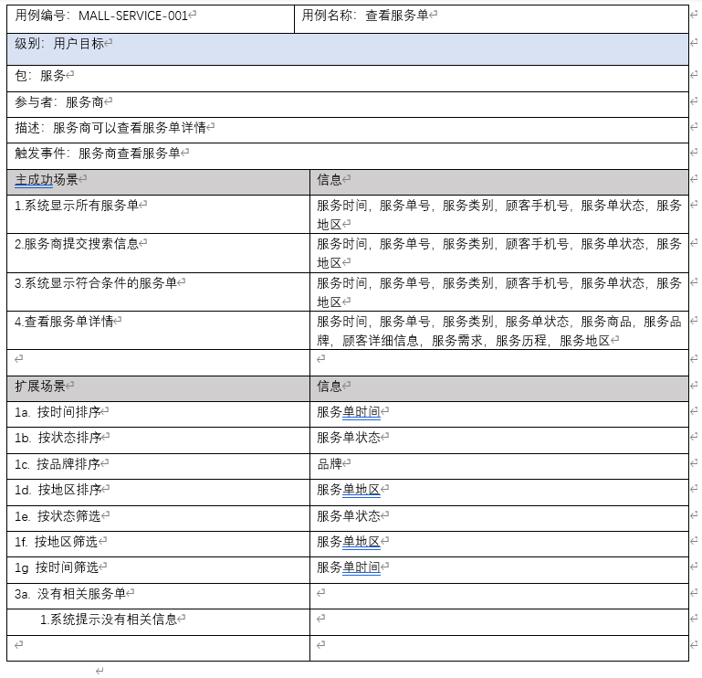
撰写服务商查看服务单的用例文字

Slide 11
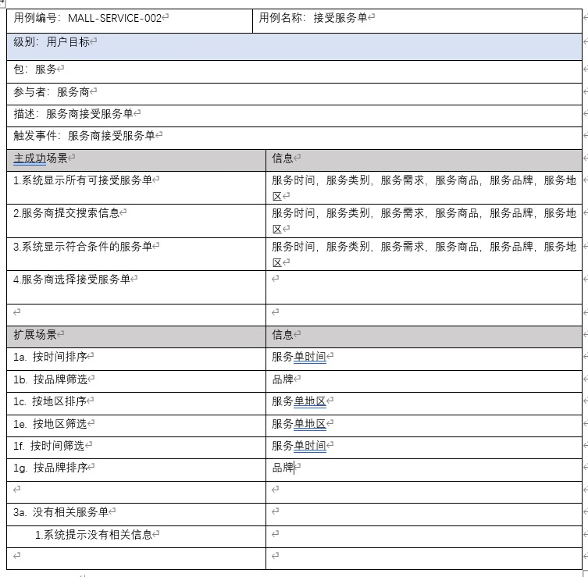
撰写服务商接受服务单的用例文字

Slide 12
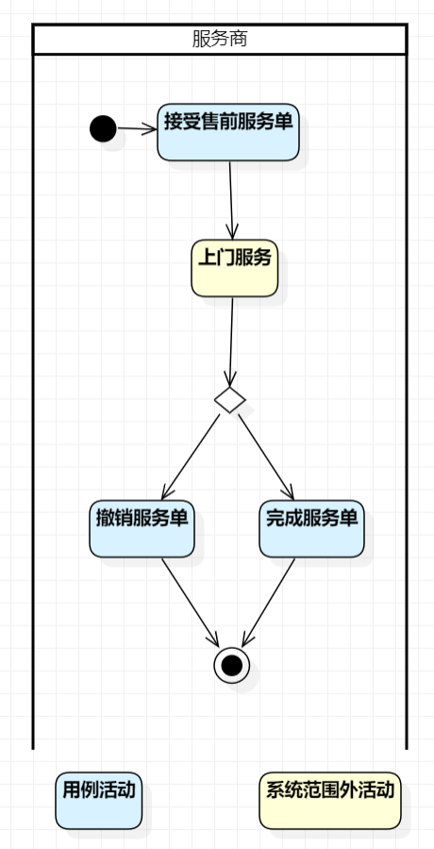
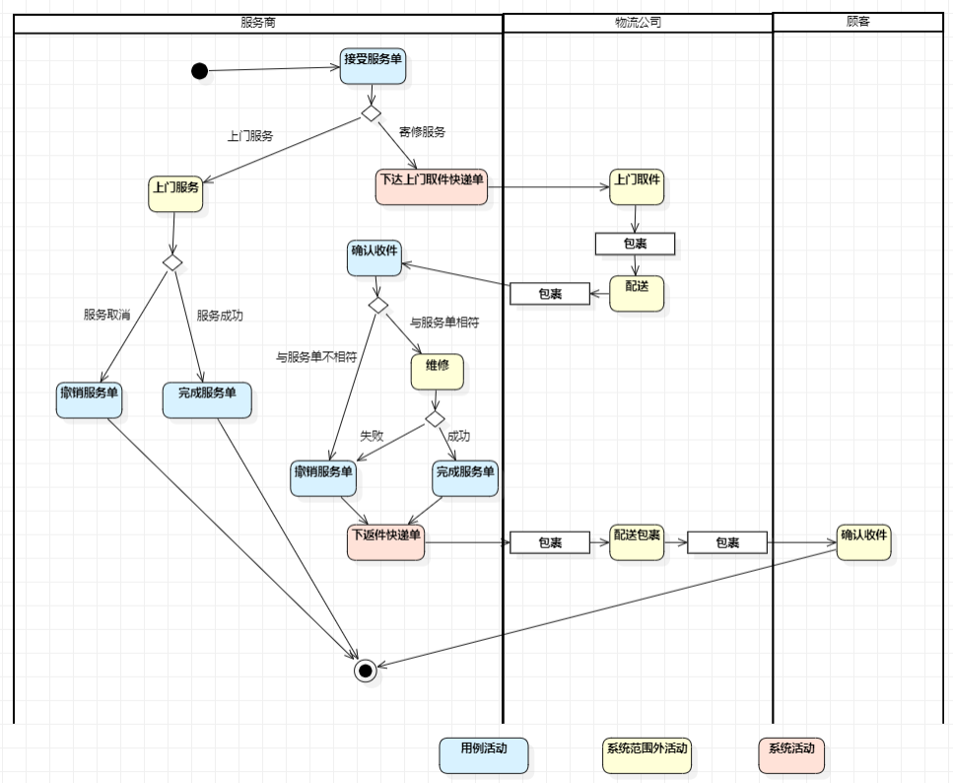
定义售前服务的业务流程
定义售后服务的业务流程

Slide 13
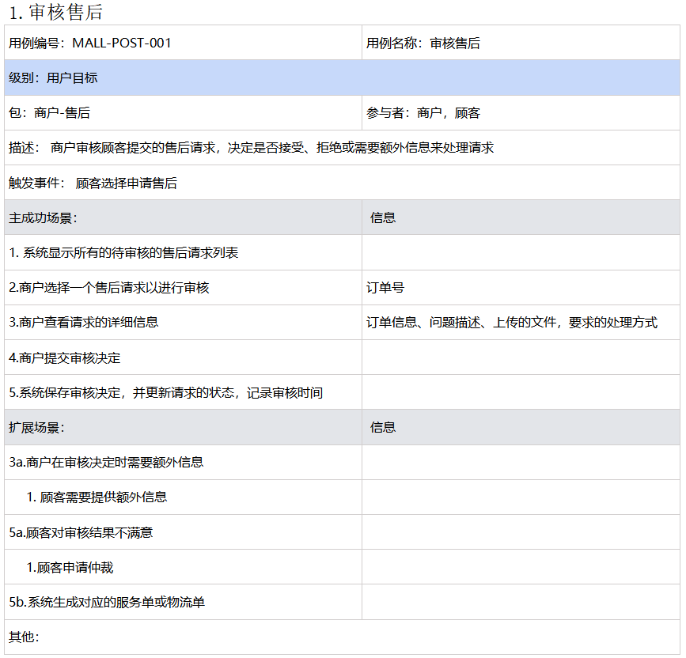
撰写商户管理服务的用例文字

Slide 14
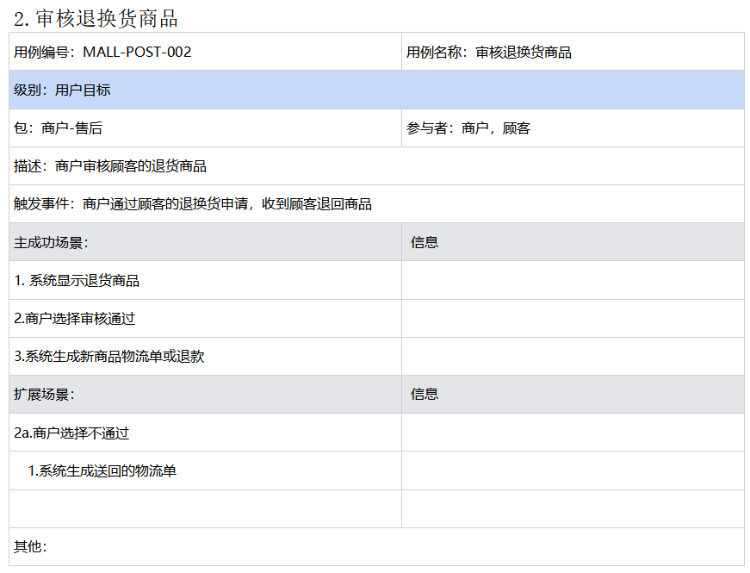

Slide 15
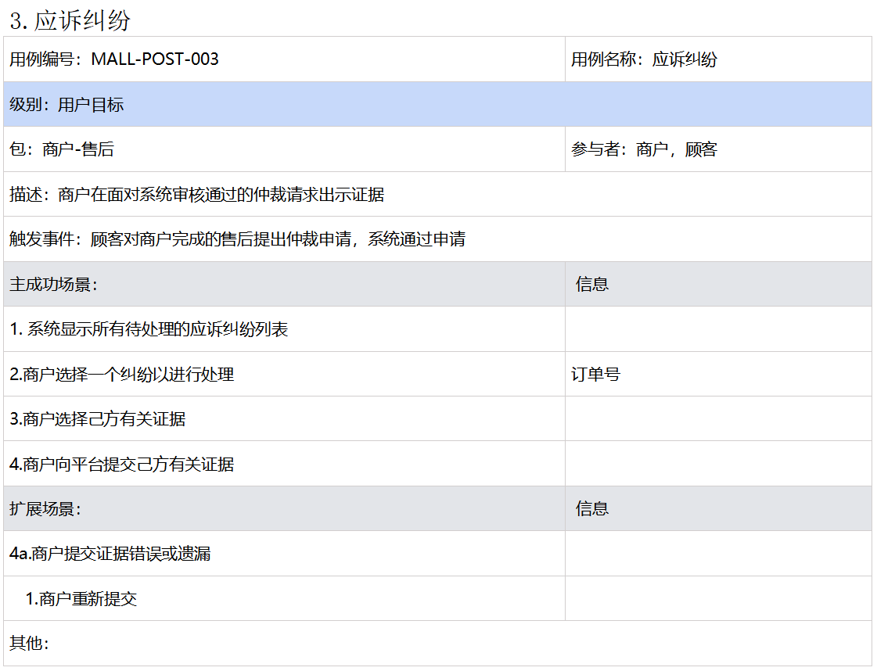

Slide 16
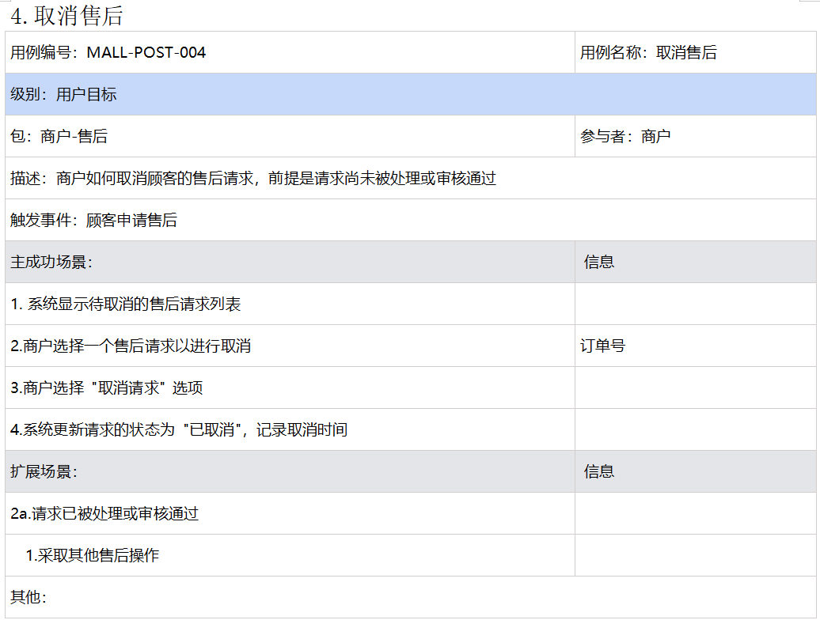

Slide 17
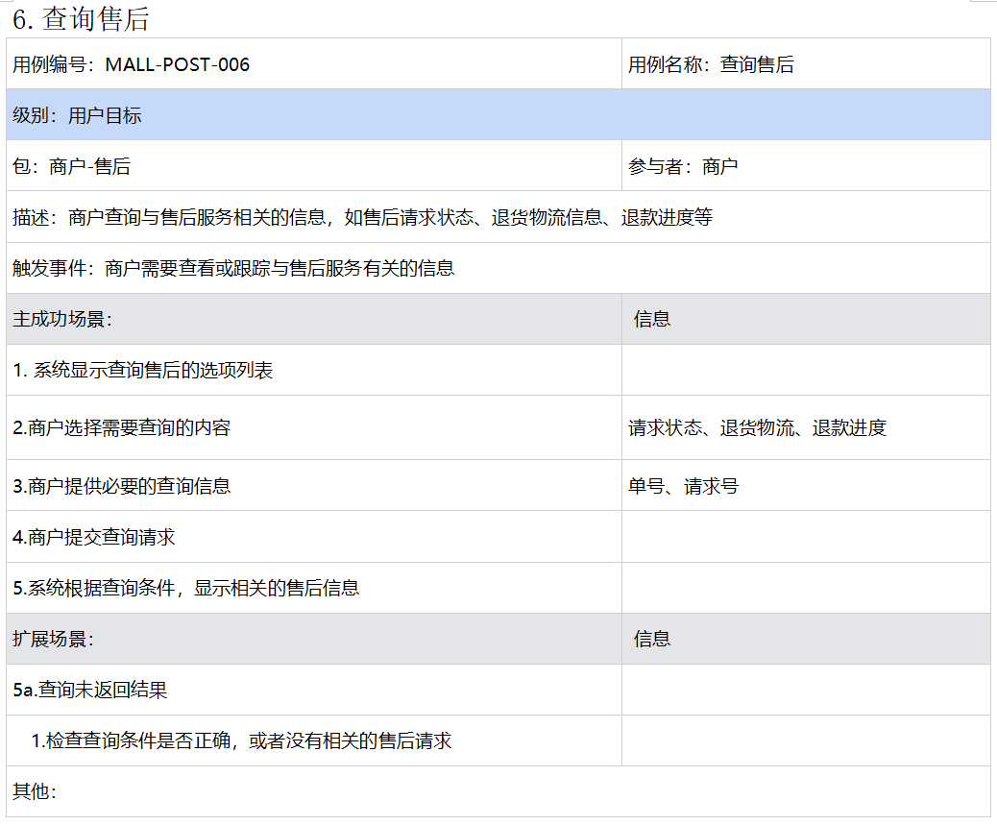

Slide 18
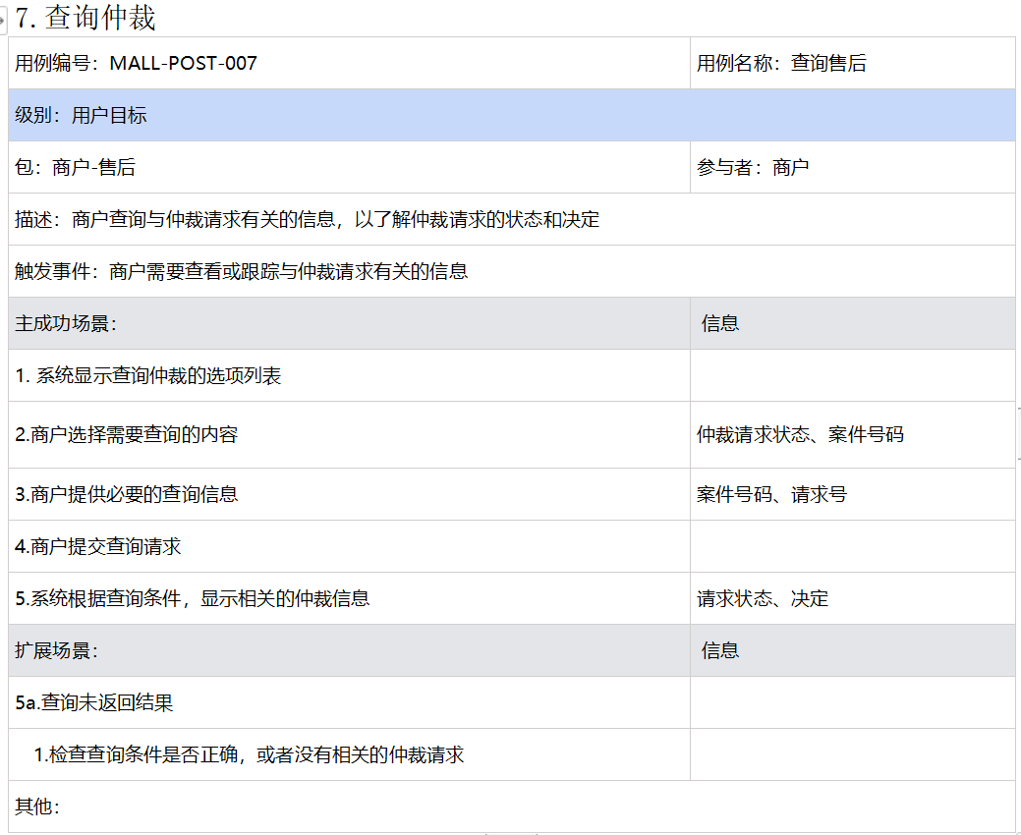

Slide 19
PART 03
顾客模块需求分析
The user can demonstrate on a projector or computer, or print the presentation and make it into a film to be used in a wider field

Slide 20
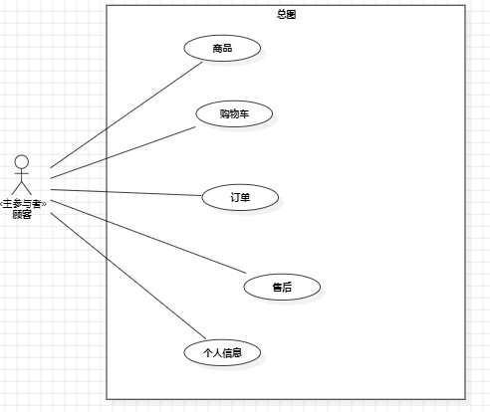
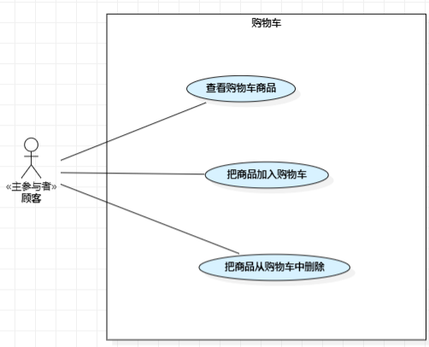
定义顾客用例
定义顾客用例（购物车相关）

Slide 21
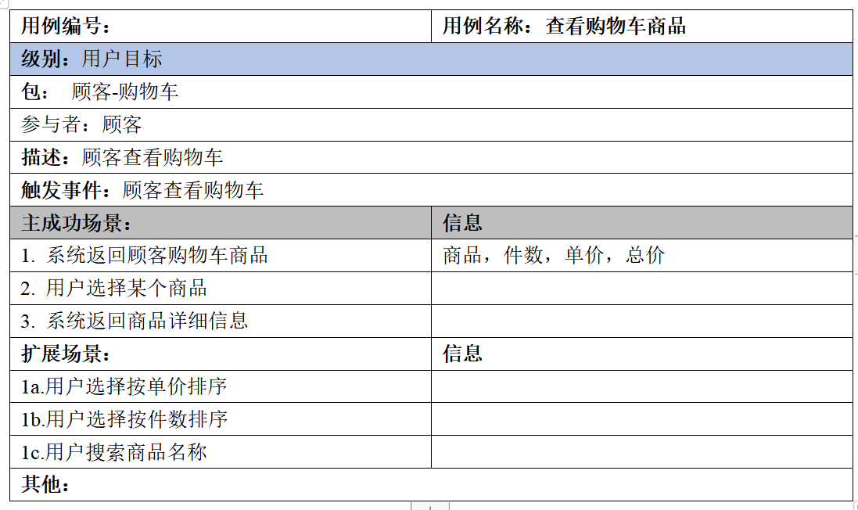
撰写顾客管理购物车的用例文字

Slide 22
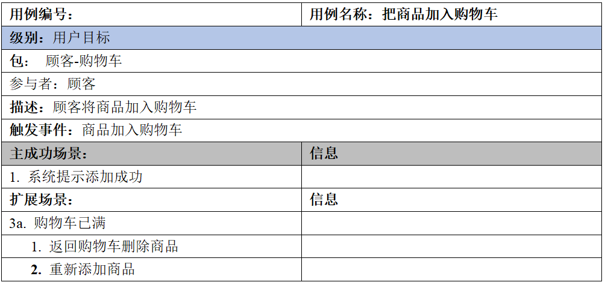
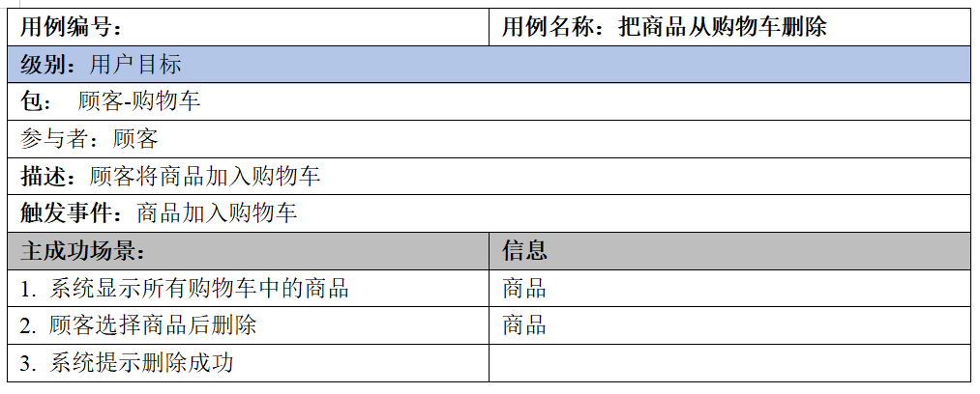
撰写顾客管理购物车的用例文字

Slide 23
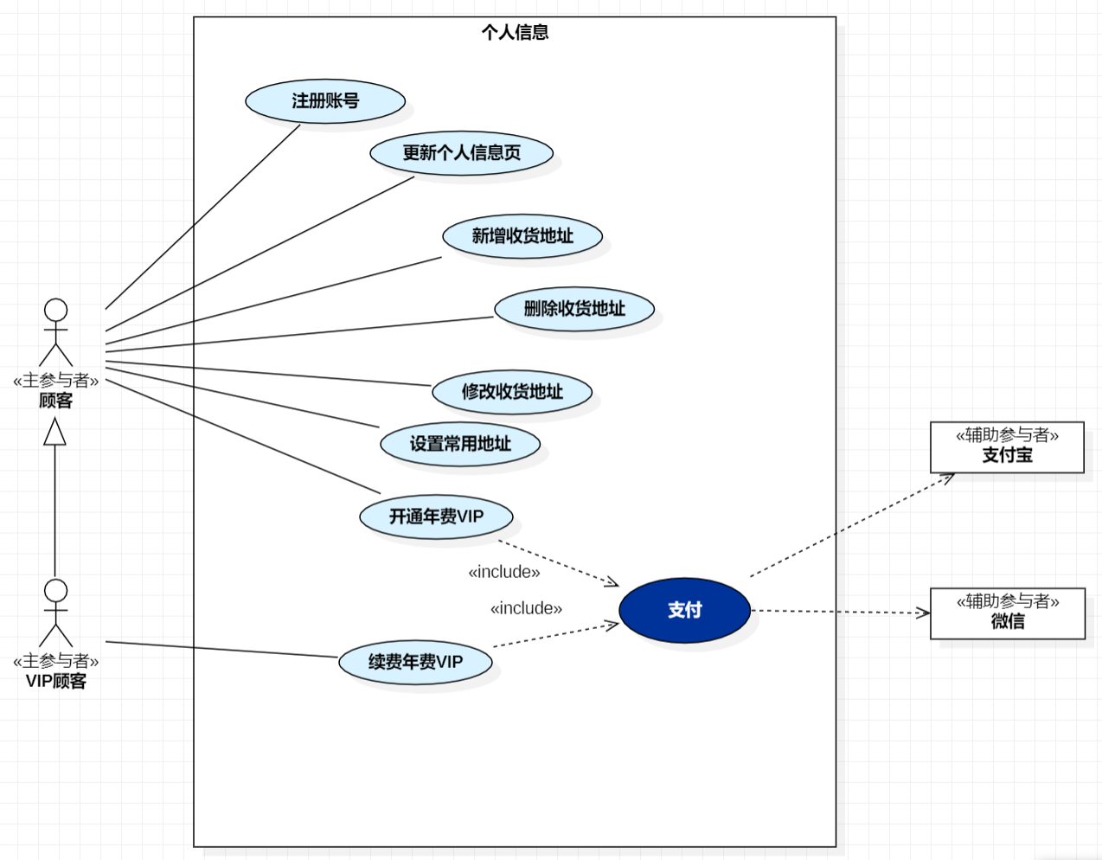
定义顾客用例（个人信息相关）

Slide 24
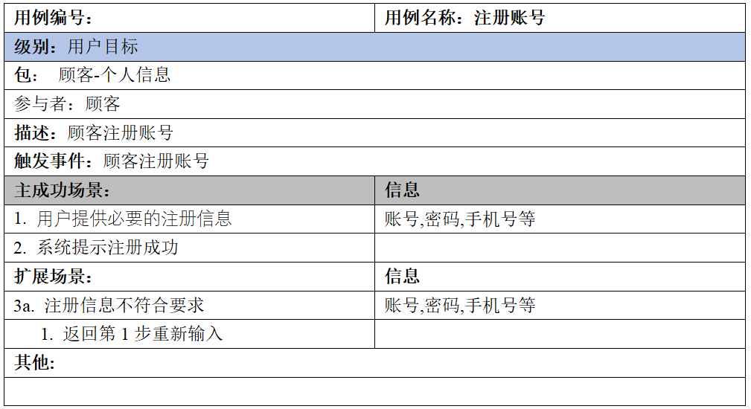
撰写顾客管理个人信息的用例文字

Slide 25
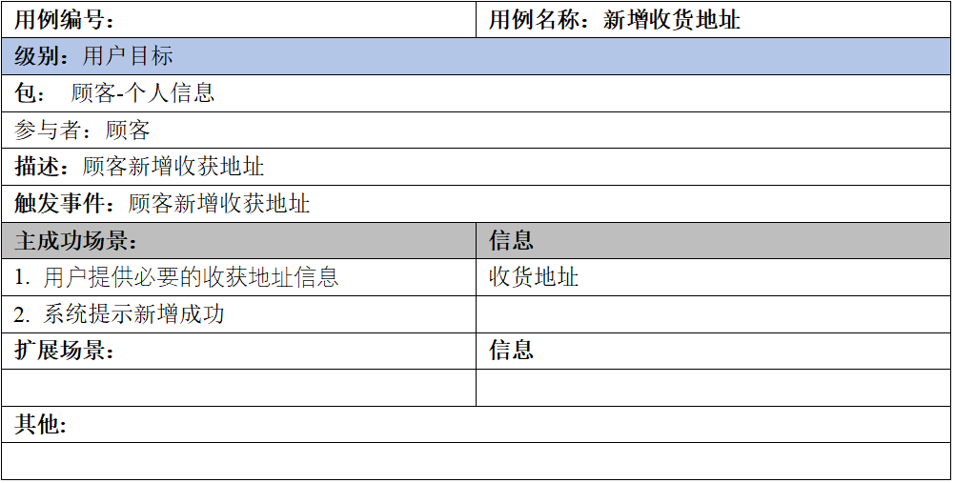
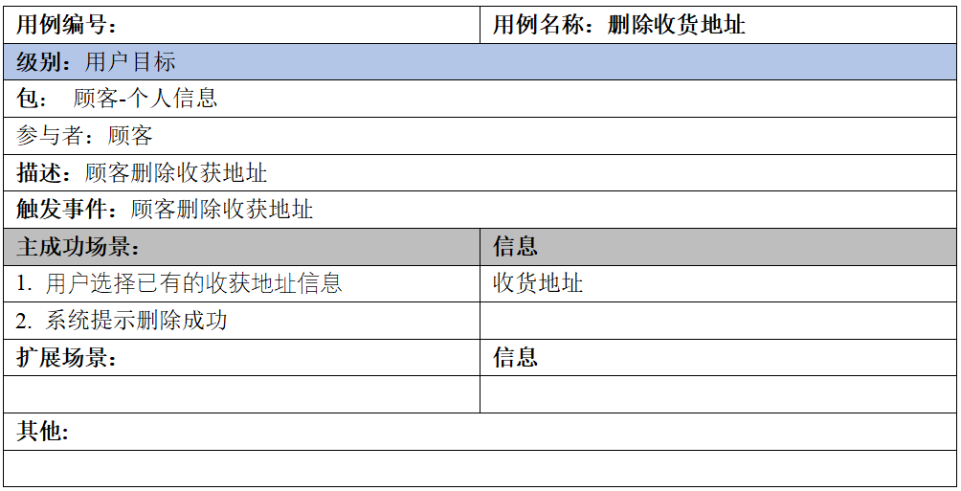
撰写顾客管理个人信息的业务流程

Slide 26
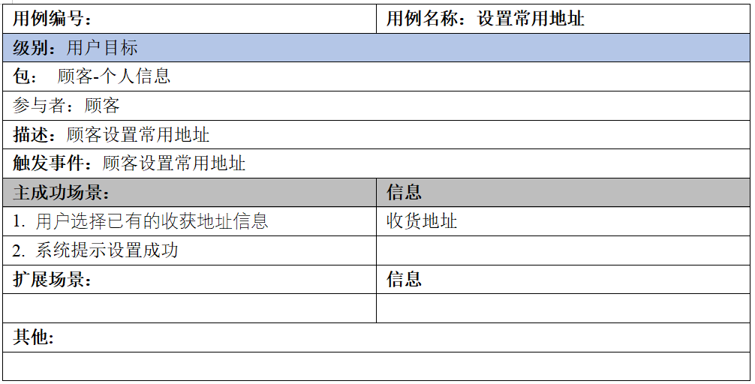
撰写顾客管理个人信息的业务流程

Slide 27
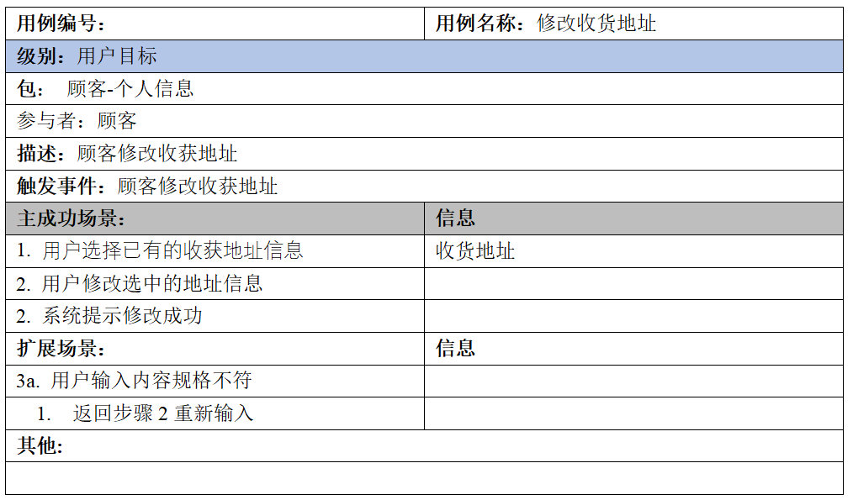
撰写顾客管理个人信息的业务流程

Slide 28
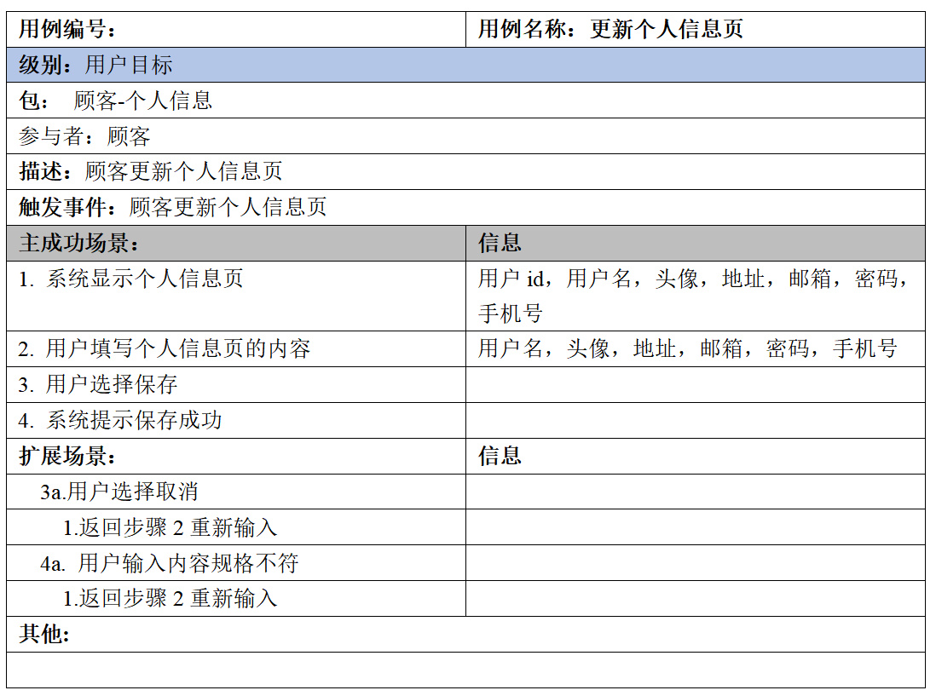
撰写顾客管理个人信息的业务流程

Slide 29
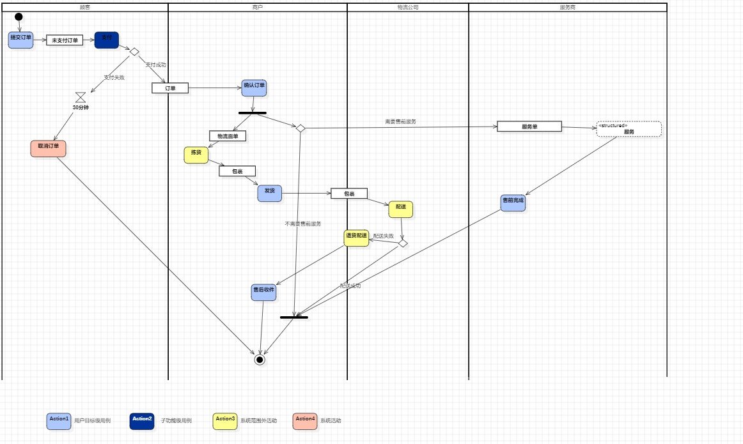
撰写顾客购买商品的业务流程

Slide 30
感谢观看！
The user can demonstrate on a projector or computer, or print the presentation and make it into a film to be used in a wider field

